Slide 1

Course : COMP6176 / Human - Computer Interaction
Year : 2019
UNDERSTANDING AND CONCEPTUALIZING INTERACTION
SESSION 02

Slide 2
LEARNING OUTCOMES
• LO 1: Describe the concept of interaction
design
• LO 2: Use guidelines, principles ,models,
and framework related with interaction
design

Slide 3
OUTLINE
^{Introduction}
^{Conceptualizing Interaction}
^{Conceptual Models}
^{Interface Metaphor}
^{Interaction Types}
Paradigms, Visions, Theories, Models and Frameworks

Slide 4

INTRODUCTION
How would you start if asked to design an application to enable people to share their photos, movies, photo, chats, documents in an efficient, safe, and enjoyable way.
Would you begin by sketching out how the interface might look, work out how the system architecture should be structured or simply start coding ?
Would you start by asking users about their current experiences of sharing files and look existing tools , begin thinking about why and how you were going to design the application

Slide 5
INTRODUCTION
It is important for Interaction Designer to realize that having a clear understanding of why and how you are going to design something , before writing any code.
It can save enormous amounts of time, effort, and money later on in the design process.

Slide 6
CONCEPTUALIZING INTERATION
When beginning a design project, it is important to be clear about the underlying assumptions and claims. By an assumption, we mean taking something for granted that requires further investigation
for example, people now want an entertainment and navigation system in their cars.
Writing down your assumptions and claims and then trying to defend and support them can highlight those that are vague or wanting. In so doing, poorly constructed design ideas can be reformulated.

Slide 7
CONCEPTUALIZING INTERATION
The following framework is intended to provide a set of core questions to aid design teams in this process:
  Are there problems with an existing product or user experience? If so, what are they?
  Why do you think there are problems?
  What evidence do you have to support the existence of these problems?
  How do you think your proposed design ideas might overcome these problems?

Slide 8
CONCEPTUALIZING INTERATION
(Your Turn)
Use the framework in the previous list to guess what the main assumptions and claims were behind 3D TV. Then do the same for curved TV, which was designed to be bendy so as to make the viewing experience more immersive. Are the assumptions similar? Why were they problematic?

Slide 9
CONCEPTUAL MODELS
What is Model ?
A model is a simplified description of a system or process that helps describe how it works

Slide 10
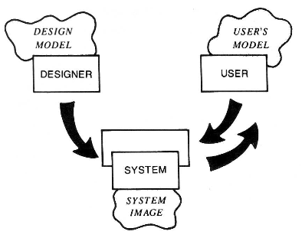
CONCEPTUAL MODELS
A conceptual model is the designer’s intended mental model for the user of the system: a set of ideas about how it is organized and operated.
Norman (1986) called this the design model:
Figure 02.01 The Star Interfaces

Slide 11
CONCEPTUAL MODELS
A conceptual model provides a working strategy and a framework of general concepts and their interrelations.
The core components are :
  Metaphors and analogies that convey to people how to understand what a product is for and how to use it for an activity. ( ex browsing, bookmarking)
  The concepts that people are exposed to through the product, including the task-domain objects, the attributes, the operations. ( ex saving, revisiting, organizing)
  The relationships between those concepts
  The mappings between the concepts and the user experience the product is designed to support or invoke. ( ex : one can revisit, most frequently visited, or saved websites).

Slide 12
CONCEPTUAL MODELS
Example of a conceptual model
A classic conceptual model : The Xerox Star
  The Star interface developed by Xerox back in 1981 revolutionized the way interfaces were designed for personal computing.
  It was designed as an office system, targeted at workers not interested in computing and was based on a conceptual model that included the familiar knowledge of an office.
  Papers, folders, filing cabinets, and mailboxes were represented as icons on the screen and were designed to possess some of the properties of their physical counterparts.

Slide 13
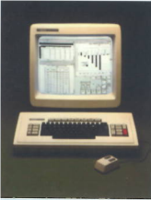
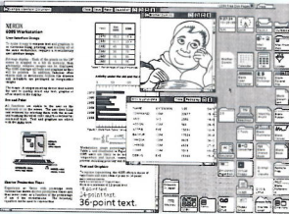
CONCEPTUAL MODELS
Example of a conceptual model ( continue) : The Star Interface ( See Figure 02.02)
a. The Xerox Star
b. GUI Interface
Figure 02.02 The Star Interfaces

Slide 14
INTERFACE METAPHOR
Interface metaphor :
  Intended to provide familiar entities that enable people to readily understand the underlying conceptual model and know what to at an interface.
Designers can fall into the trap of trying to create a virtual object to resemble a familiar physical object that is itself badly designed.
A well-known example is the virtual calculator, which is designed to look and behave like a physical calculator.

Slide 15
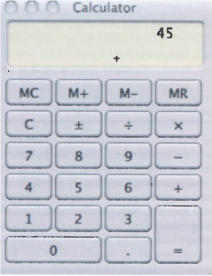
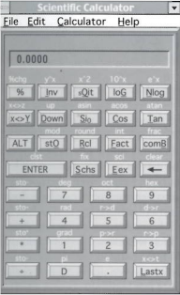
INTERFACE METAPHOR
In figure 02.03 the Mac calculator has simpler interface that supports a basic set of calculations which all that most people need to do.
In figure 02.04 the design of Scientific calculator has even gone as far as replicating functions needing shift keys
Figure 02.03 The Mac Calculator
Figure 02.04 Scientific Calculator

Slide 16
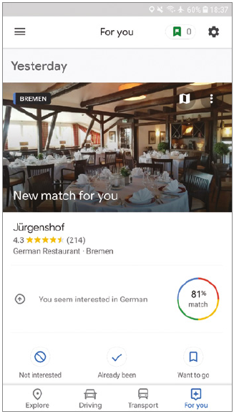
INTERFACE METAPHOR
An interface metaphor that has become popular in the last few years is the card.
Many of the social media apps, such as Facebook, Twitter, and Pinterest, present their content on cards
Figure 02.05 Google Now Card for restaurant recommendation in Germany

Slide 17
INTERACTION TYPES
Interaction Types : there are the ways a person interacts with a product or application.
There are five main types :
  Instructing
  Conversing
  Manipulating
  Exploring
  Responding

Slide 18
INTERACTION TYPES
INTRUCTING
This type of interaction describes how users carry out their tasks by telling the system what to do .
This can be done in a number of ways, including :
  Typing in commands
  Selection options from menus
  Speaking aloud commands
  Gesturing
  Pressing buttons or using a combinations of function keys

Slide 19
INTERACTION TYPES
INTRUCTING
Example :
  Operating systems like Unix and Linux where users issue instruction at the prompt as a command or set of commands.
  In Windows use control keys or the selection of menu options via a mouse, touch pad, touch screen

Slide 20
INTERACTION TYPES
INTRUCTING
One the main benefits of instruction is :
  The interaction is quick and efficient
  It is particularly fitting where there is a need to frequently repeat actions performed on multiple objects.
  Examples includes the repetitive actions of saving, deleting and organizing files.

Slide 21
INTERACTION TYPES
CONVERSING
This form of interaction is based on the idea of a person having a conversation with a system, where the system acts as a dialog partner.
The system is designed to respond in a way another human being might when having a conversations.
It differs from the activity of instructing as it encompasses a two-way communication process with the system acting like a partner rather than a machine that obeys orders.

Slide 22
INTERACTION TYPES
CONVERSING
The kind of conversation :
  Simple voice-recognition
  Menu-driven systems with via phones
  More complex natural-language based systems that involve system parsing and responding to queries typed by the user.
The main benefit uses a conversational style is : allow people especially novices, to interact with a system in a way that is familiar to them.

Slide 23
INTERACTION TYPES
CONVERSING
The example :
  The search engine Ask Jeeves for Kids
  (www.askjeeves.com)
  Online agents, Anna in IKEA help Center (www.ikea.com)
A problem that can arise from using a conversational-based interaction type :
  Certain kinds of task are transformed into cumbersome and one-sided interaction. Example : automated phone based systems

Slide 24
INTERACTION TYPES
MANIPULATING
This form of interaction involves manipulating objects and capitalizes on users’ knowledge of how they do so in the physical world. For example digital objects can be manipulated by moving, opening, holding, closing, placing)
Actions that are not possible with objects in the real world such as zooming in and out, stretching and shrinking can done with this form of interaction.

Slide 25
INTERACTION TYPES
MANIPULATING
Direct Manipulation : A framework that has been highly influential in informing the design of GUI application . ( Sneiderman,1983).
Direct manipulation interfaces are assumed to enable users to feel that they are directly controlling the digital objects represented by the computer.

Slide 26
INTERACTION TYPES
MANIPULATING
The three core principles are :
  Continuous representation of the objects and actions of interest.
  Rapid reversible incremental actions with immediate feedback about the objet of interest.
  Physical actions and button pressing instead of issuing commands with complex syntax.

Slide 27
INTERACTION TYPES
MANIPULATING
The benefits of direct manipulation :
  Helping beginners learn basic functionality rapidly.
  Enabling experienced users to work rapidly
  Allowing infrequent users to remember how to carry out operations over time
  Preventing the need for error messages
  Showing users immediately how their actions are furthering their goals
  Reducing users’ experience of anxiety
  Helping users gain confidence and mastery and feel in control

Slide 28
INTERACTION TYPES
MANIPULATING
Apple was one the first computer companies to design an operating environment that used direct manipulation as its central mode of interaction.
Application that used direct manipulation interfaces such word processor, video games, leaning tools, and image editing tools.
In particular, not all task can be described by objects and not all actions can be undertaken directly.

Slide 29
INTERACTION TYPES
EXPLORING
This mode of interaction involves users moving though virtual or physical environments
For example , users can explore aspects of a virtual 3D environment, such as the interior of a building.
Similar to direct manipulation and direct manipulative, the fundamental idea is to enable people to explore and interact with an environment, be it physical or digital, by exploiting their knowledge of how they move and navigate through existing spaces.

Slide 30
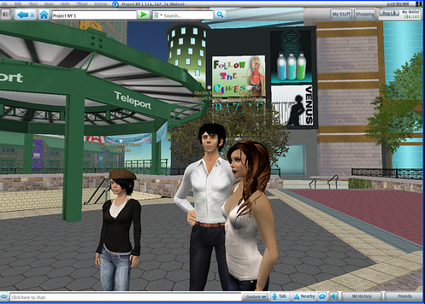
INTERACTION TYPES
EXPLORING
Many 3D virtual environments have been built : virtual universities, virtual parties, Second LIFE ( Figure 02.06).
Figure 02.06 Second Life
Source : www.ubernoggin.com

Slide 31
INTERACTION TYPES
RESPONDING
This mode of interaction involves the system taking the initiative to alert, describe, or show the user something that it “thinks” is of interest or relevance to the context the user is presently in.
Smartphones and wearable devices are becoming increasingly proactive in initiating user interaction in this way, rather than waiting for the user to ask, command, explore, or manipulate

Slide 32
INTERACTION TYPES
RESPONDING
Example :
  a fitness tracker that notifies the user of a milestone they have reached for a given activity, for example, having walked 10,000 steps in a day.
  Google Lens, after taking a photo of a friends cute dog in the park, goole lens will automatically pop up information that identifies the breed of the dog (Figure 02.07)

Slide 33
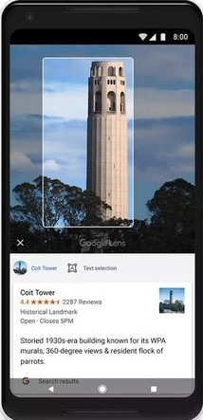
INTERACTION TYPES
RESPONDING
Example :
Figure 02.07 Google
Source : www.google.com

Slide 34
^{PARADIGMS, VISIONS,} ^{THEORIES,}
^{MODELS AND FRAMEWORKS}
PARADIGMS
Other sources of inspiration and knowledge that are used to inform design and guide research are paradigms, theories, models and frameworks
( Carroll,2003)
A paradigms refers to a general approach that has been adopted by a community of researchers and designers for carrying out their work.
In the 1980s, the prevailing paradigm in human computer interaction was how to design user-centered application for the desktop computer.

Slide 35
^{PARADIGMS, VISIONS,} ^{THEORIES,}
^{MODELS AND FRAMEWORKS}
PARADIGMS
1980s :
  Task analytic and usability methods were developed based on individual user’s cognitive capabilities
  The acronym WIMP ( Window, Icons, Menus, and Pointer was used as a way of characterizing the core features of an interface for a single user.
  It was later superseded by the GUI (Graphical User Interface).

Slide 36
^{PARADIGMS, VISIONS,} ^{THEORIES,}
^{MODELS AND FRAMEWORKS}
PARADIGMS
1990s
  A big influence in the more recent paradigmatic changes was Weiser’s vision of ubiquitous technology.
  Weiser proposed that computers would become part of the environment, embedded in a variety of everyday objects, devices, and displays.
  Since the late 1990s many researcher have been concerned with how to embed and augment the environment with various computational resources to provide information and services when and where desired.

Slide 37
^{PARADIGMS, VISIONS,} ^{THEORIES,}
^{MODELS AND FRAMEWORKS}
VISIONS
Visions of the future, like Mark Weiser’s vision of ubiquitous technology, provide a powerful driving force that can lead to a paradigm shift in terms of what research and development is carried out in companies and universities.
A current vision that has become pervasive is AI. Both utopian and dystopian visions are being bandied about on how AI will make our lives easier on the one hand and how it will take our jobs away on the other.

Slide 38
^{PARADIGMS, VISIONS,} ^{THEORIES,}
^{MODELS AND FRAMEWORKS}
VISIONS
Another challenge is to develop new kinds of interfaces and conceptual models that can support the synergy of humans and AI systems, which will amplify and extend what they can do currently.
This could include novel ways of enhancing group collaboration, creative problem-solving, forward planning, policy-making, and other areas that can become intractable, complex, and messy, such as divorce settlements.

Slide 39
^{PARADIGMS, VISIONS,} ^{THEORIES,}
^{MODELS AND FRAMEWORKS}
VISIONS
Many new challenges, themes, and questions have been articulated through such visions, including the following:
  How to enable people to access and interact with information in their work, social, and everyday lives using an assortment of technologies ?
  How to design user experiences for people using interfaces that are part of the environment but where there are no obvious controlling devices ?
  How and in what form to provide contextually relevant information to people at appropriate times and places to support them while on the move ?
  How to ensure that information that is passed around via interconnected displays, devices, and objects is secure and trustworthy ?

Slide 40
^{PARADIGMS, VISIONS,} ^{THEORIES,}
^{MODELS AND FRAMEWORKS}
THEORIES
a theory is a well-substantiated explanation of some aspect of a phenomenon.
For example : cognitive theories about human memory were used in the 1980s to determine the best ways of representing operations, given people’s memory limitations.
One of the main benefits of applying such theories in interaction design is :
  To help identify factors ( cognitive, social and affective) relevant to the design and evaluation of interactive products.

Slide 41
^{PARADIGMS, VISIONS,} ^{THEORIES,}
^{MODELS AND FRAMEWORKS}
MODELS
A Model is a simplification of some aspect of human-computer interaction intended to make it easier for designer to predict and evaluate alternative designs.
Example :
  Norman ( 1988) develop a number of models of user interaction based on theories of cognitive processing.
  Card, Moran, and Newell’s keystroke model ( 1980) that used by a number of researchers and designers as a predictive way of analyzing user performance for different interfaces to determine which would be the most effective.

Slide 42
^{PARADIGMS, VISIONS,} ^{THEORIES,}
^{MODELS AND FRAMEWORKS}
FRAMEWORKS
A Framework is a set of interrelated concepts and / or a set of specific questions that is intended to inform a particular domain area, online communities, or an analytic method ( e.g. ethnographic studies).
A Framework offers advice to designers as to what to design or look for.
Framework based on theories of human behavior, but increasingly being developed from the experiences of actual design practice and the findings arising from user studies.

Slide 43
^{PARADIGMS, VISIONS,} ^{THEORIES,}
^{MODELS AND FRAMEWORKS}
FRAMEWORKS
For example Table 2.1 shows part of a new framework proposed for human-computer interaction contrasting old and new concepts
( Rogers,2009)
Concern | Past | Future
Frame of reference | Users | context
Method, theory, perspective | - Scientific approach - Interaction design | - Pluralistic - Mixing
Output | Ethnographies Models and tools for analysis Design guidance | Insights Creating new ways of experiencing Value-based analyses

Slide 44
^{PARADIGMS, VISIONS,} ^{THEORIES,}
^{MODELS AND FRAMEWORKS}
FRAMEWORKS
The framework of Normans ( 1988) :
  explication of the relationship between the design of a conceptual model and a user’s understanding of it.
  Comprises three interacting components :
    the designer’s model
      The model the designer has of how the system should work.
    The system image
    how the system actually works is portrayed to the user through the interface, manuals, help facilities, and so on.

Slide 45
^{PARADIGMS, VISIONS,} ^{THEORIES,}
^{MODELS AND FRAMEWORKS}
FRAMEWORKS
  Comprises three interacting components :
    The user’s model :
      How the user understands how the system works.
  This framework makes explicit the relationship between how a system should function, how It is presented to users, and how it is understood by them.

Slide 46
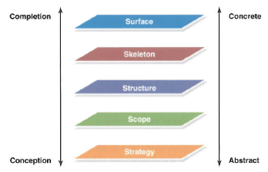
^{PARADIGMS, VISIONS,} ^{THEORIES,}
^{MODELS AND FRAMEWORKS}
FRAMEWORKS
Recent framework in design practice is Garrett’s (2010) user experience development process. (Figure 02.08)
The framework has been used primarily to guide web development and understand the elements of the user experience.
Figure 02.08 The user experience framework

Slide 47
^{REFERENCES}
Interaction Design 5th Edition 2019, Chapter 3
http://www.inf.ed.ac.uk/teaching/courses/hci/1314/lecs/Lecture2.pdf
http://www.inf.ed.ac.uk/teaching/courses/hci/0809/lecs/4_models-4up.pdf
https://www.intechopen.com/online-first/sources-of-computer-metaphors-for-visualization-and-human-computer-interaction

